Slide 1
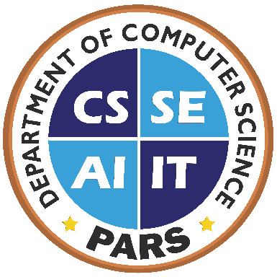
Programming Fundamentals
Lecture No. 01

Slide 2
What Will You Learn Today?
Programming Concepts and their Importance
Computer Program
Critical Skills
Programming Languages
Bloodshed Dev-C++ Installation
2

Slide 3
Point of Think
Why you are taking this course?
3

Slide 4
Importance of the Course
Core of Computer Science
Many courses depend on this course
Object Oriented Programming
Data Structures
Web Development
Mobile Development
Compiler Construction
….
4

Slide 5
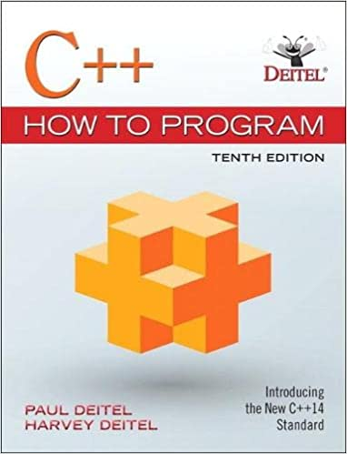
Text Book
C++ How to Programming (10th Edition)
Paul Deitel, Harvey Deitel
Prentice Hall
5

Slide 6
Course Contents
Programming Constructs & Building Blocks
Variables & Expressions
Control structures
Selection / Multiple Selection
Iterations
Built-in Functions
User-defined Functions
Function Overloading
Function Templates
6

Slide 7
Course Contents
Recursion
Arrays
Multi-Dimensional Arrays
Pointers
Dynamic Memory Allocation
Structures
Class
Operator Overloading
Files Handling
7

Slide 8

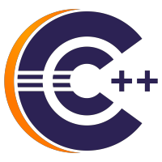
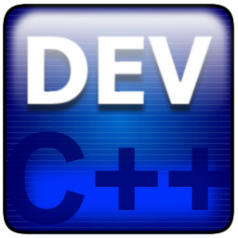

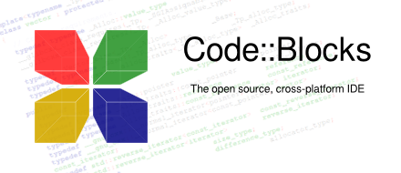




Development Environment
Dev-Cpp 5.11
Eclipse CDT
Ultimate++
Visual Studio
8

Slide 9
Computer Architecture
The modern day computer has two major classifications:
Hardware
Software
There are two main categories of software
System software
Application Software
9

Slide 10
Computer Program (Software)
“Program is – a precise sequence of steps to solve a particular problem.”
A sequence of instructions is called a computer program or software
Operating systems, Application software, games etc.
These instructions are written in a programming language
All Software development is done in some programming language
10

Slide 11



Critical Skills
Analysis
Critical Thinking
Pay Attention to Detail
11

Slide 12
Programming Languages
Machine Language
Assembly Language
High level languages
Procedural Languages
Object Oriented Languages
12

Slide 13
Programming Languages
Machine Language
Written in the form of 0 & 1
Computer directly understands
Machine Dependent
Assembly Languages
Use Naturally understandable symbols called “Mnemonics”
Load 5, Load 1, Add
Assemblers are used as interpreter
13

Slide 14
Programming Languages
High Level Languages
Use naturally understandable language
Compilers are used as interpreter
IDE’s are use for rapid development like .NET environment, Visual Basic, Visual C++ and Visual C#
14

Slide 15
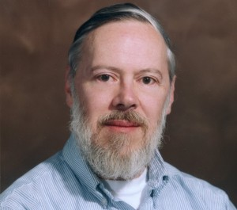
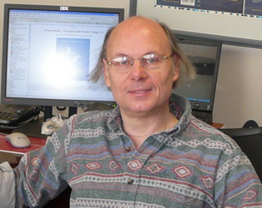
C++ as a Programming Language
Extended version of C language
C is evolved by Dennis Ritchie
C++ is developed by Bjarne Stroustrup
Why C++ ???
Mother of almost all programming languages
15

Slide 16
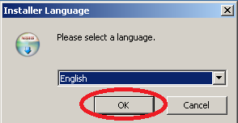
Bloodshed Dev-C++ Installation
16

Slide 17
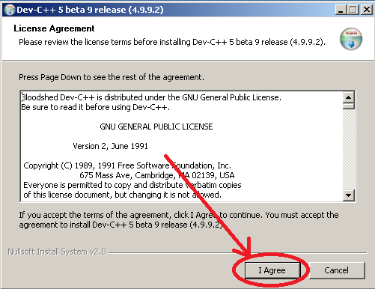
Bloodshed Dev-C++ Installation
17

Slide 18
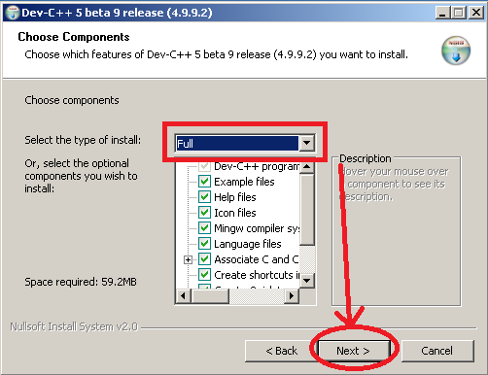
Bloodshed Dev-C++ Installation
18

Slide 19
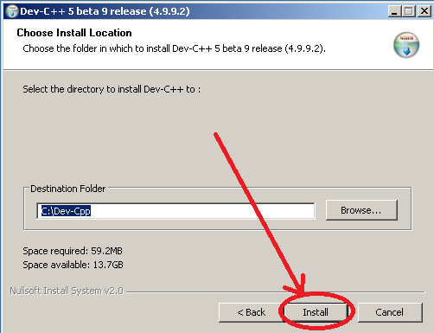
Bloodshed Dev-C++ Installation
19

Slide 20
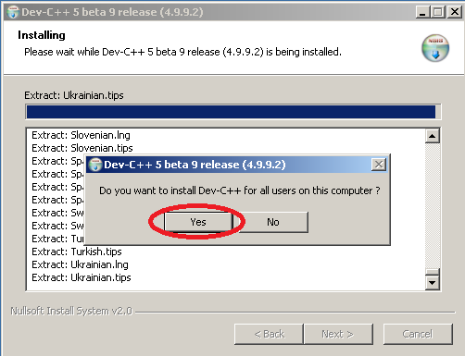
Bloodshed Dev-C++ Installation
20

Slide 21
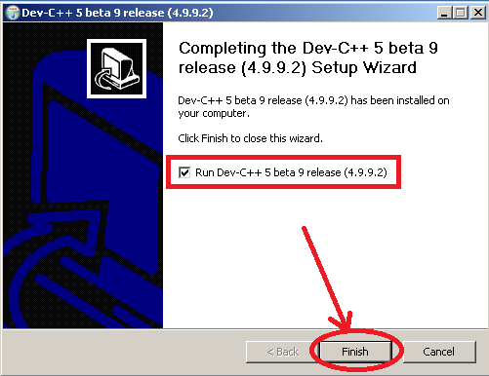
Bloodshed Dev-C++ Installation
21

Slide 22
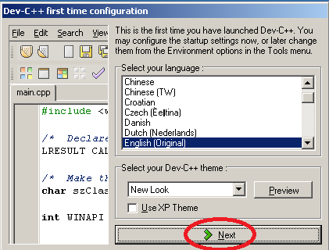
Bloodshed Dev-C++ Installation
22

Slide 23
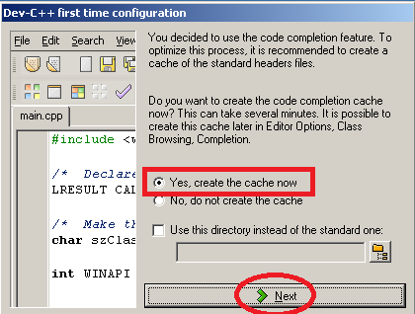
Bloodshed Dev-C++ Installation
23

Slide 24
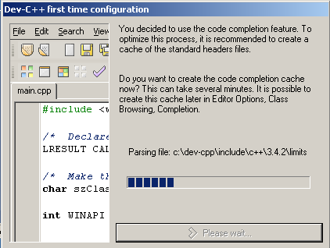
Bloodshed Dev-C++ Installation
24

Slide 25
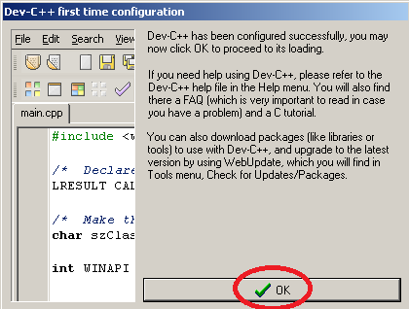
Bloodshed Dev-C++ Installation
25

Slide 26
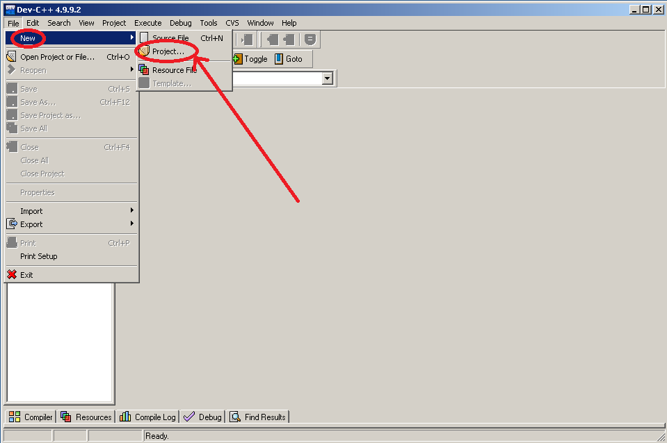
Bloodshed Dev-C++ Installation
26

Slide 27
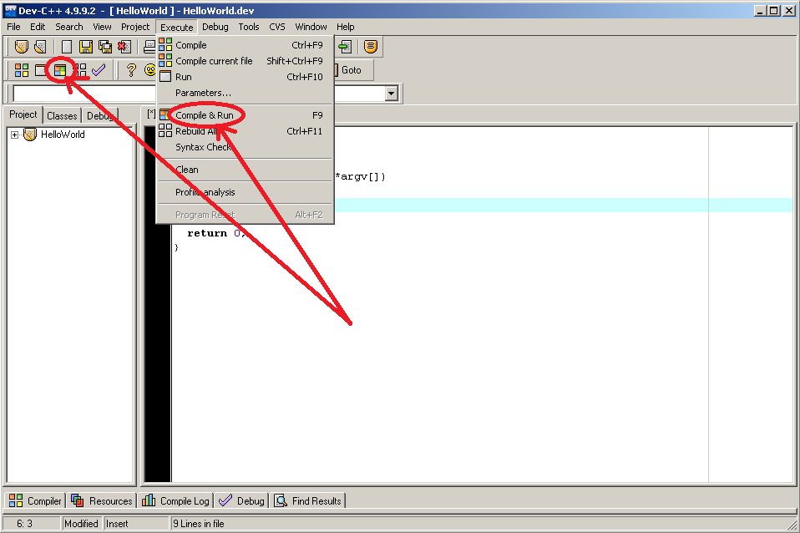
Bloodshed Dev-C++ Installation
27

Slide 28
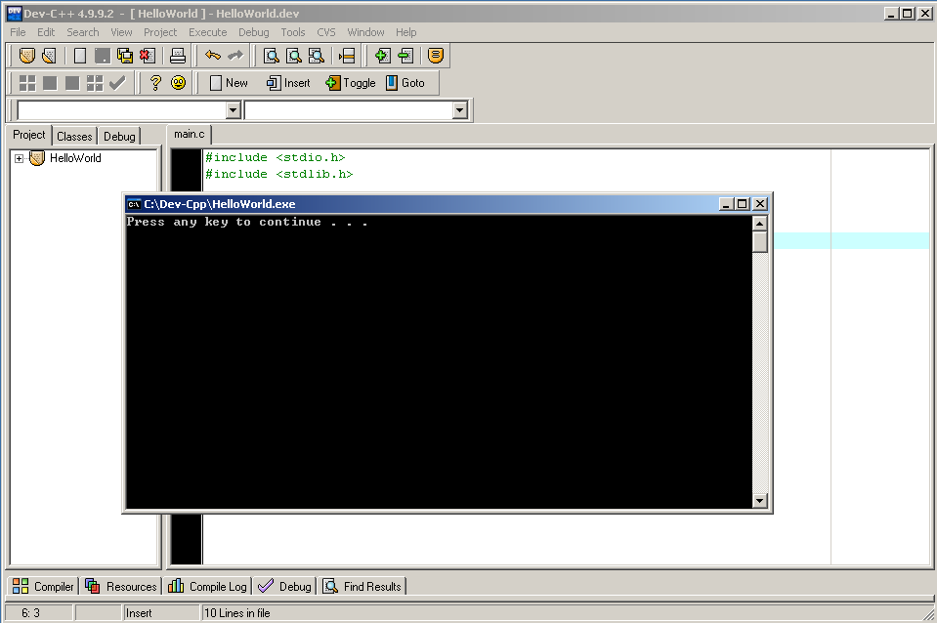
Bloodshed Dev-C++ Installation
28

Slide 29
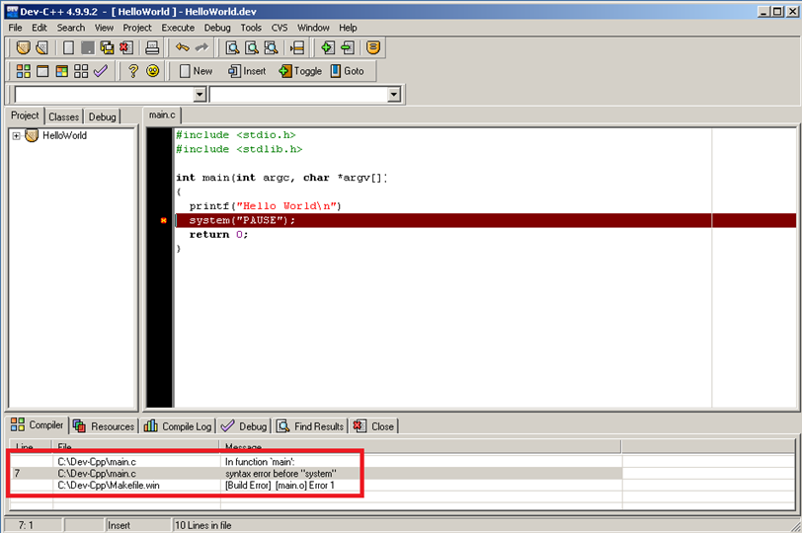
Bloodshed Dev-C++ Installation
Missing semi-colon
Double click on the error
29

Slide 30
Recap
Programming Concepts and their Importance
Computer Program
Critical Skills
Programming Languages
Bloodshed Dev-C++ Installation
30

Slide 31

Questions
31

